Slide 1
Aesthetics
CP1403
Design Thinking

Slide 2
Topics
Understanding the uses and roles of aesthetics in software design
Color
Typography
Visual Communication

Slide 3
Readings
Design for Software: A playbook for developers , Chapter 7-8

Slide 4
Color
Color can evoke emotions and create different psychological implications
Green means go/safe/ready
Color create sense of consistency
Color provide brand identity

Slide 5
Activity 1 - Psychology of Color (10 minutes)
Group discussion
Discuss what emotions /feelings these colors represent or may evoke?

Slide 6
Understanding Color
Hue, Saturation, Brightness, Contrast
Color Models
Cold vs Warm Colors
Color Palette

Slide 7
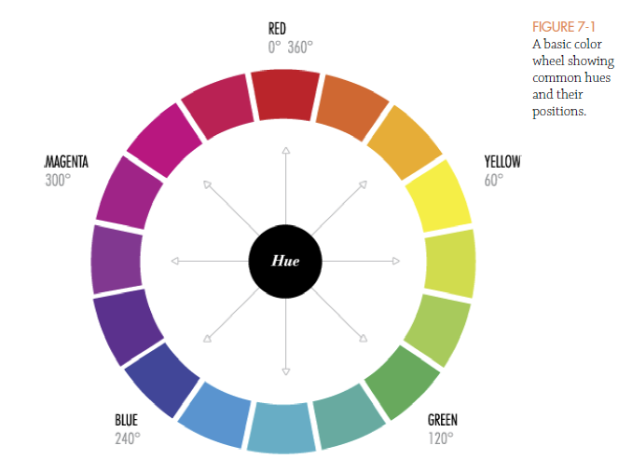
Understanding Color - Hue
Hue is somewhat synonymous to what we usually refer to as "colors".
The different hues have different wavelenghts in the spectrum.

Slide 8
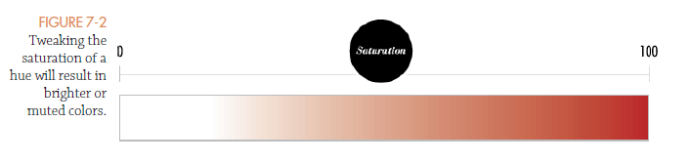
Understanding Color - Saturation
Saturation is the intensity of a color
Stronger or weaker hues affect the overall appearance of the color.

Slide 9
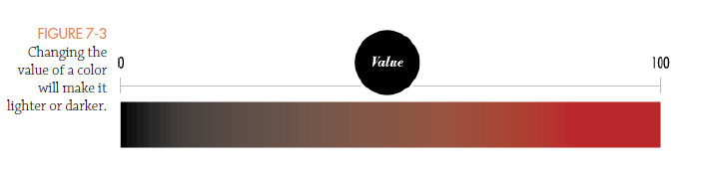
Understanding Color - Brightness
Brightness is how light or dark a color is, it is how much black the color contains.

Slide 10
Color Model
A color model is an abstract mathematical model for describing color in a particular color space.
Examples of color models:
HSB
RGB
CMYK
HSL

Slide 11
Color Model – HSB/HSV
HSB stands for Hue, Saturation, and Brightness.
you can describe any color with three numbers.
The first number represents the hue of a color (0 to 360)
The second number represents saturation (0 to 100)
the third number (brightness) represents the value or amount of black in a color. (0 and 100)

Slide 12
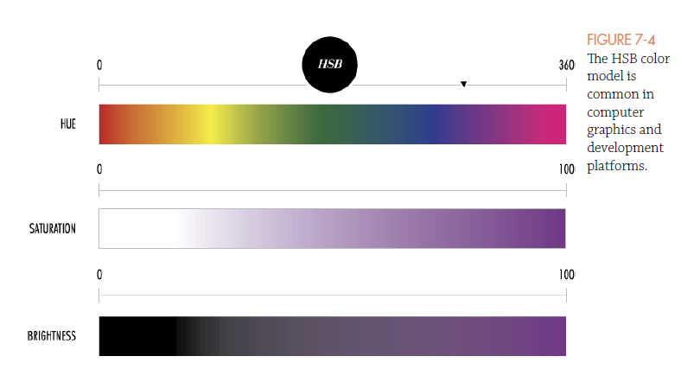
Color Model - HSB

Slide 13
Color Model - RGB
RGB stands for Red, Green, and Blue
Each pixel on your screen is made up of three tiny individual color stripes—red, green, and blue.
three primary colors (red, green, and blue) is represented with a number ranging from 0 to 255, i.e. 255^3 (more than 16 million) unique colors.
this model is based on light, it’s an additive model, meaning when red, green, and blue are combined, they create white.

Slide 14
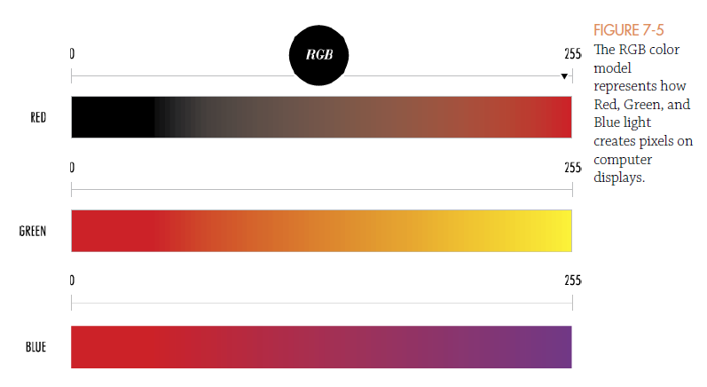
Color Model - RGB

Slide 15
Color Model - CMYK
CMYK stands for Cyan, Magenta, Yellow and Key (Black).
This model is most often used in print work , four colors represent the four inks used by most printers.
CMYK is a subtractive model, meaning when cyan, yellow, and magenta are combined, they create black.

Slide 16
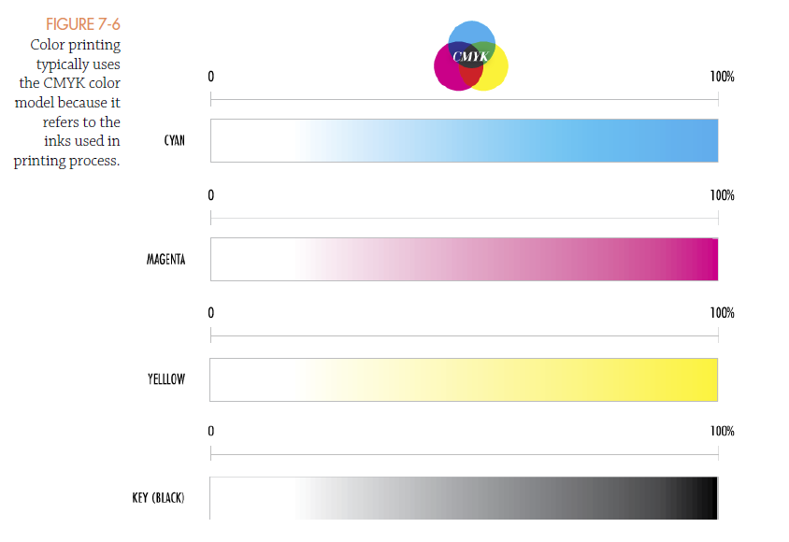
Color Model - CMYK

Slide 17
Color Model - HSL
HSL is similar to HSB in that the H and S (hue and saturation) are represented in the same way.
In the HSL model, a color with 100-percent lightness appears white, whereas 50-percent lightness produces the pure hue.
For example, pure red is represented by hsl(0, 100, 50) while hsb is (0,100,100).
Programmatically calculating gradients or dynamically generating colors in code with HSL is a lot easier than trying to guess at RGB values to produce the shade of a given color

Slide 18
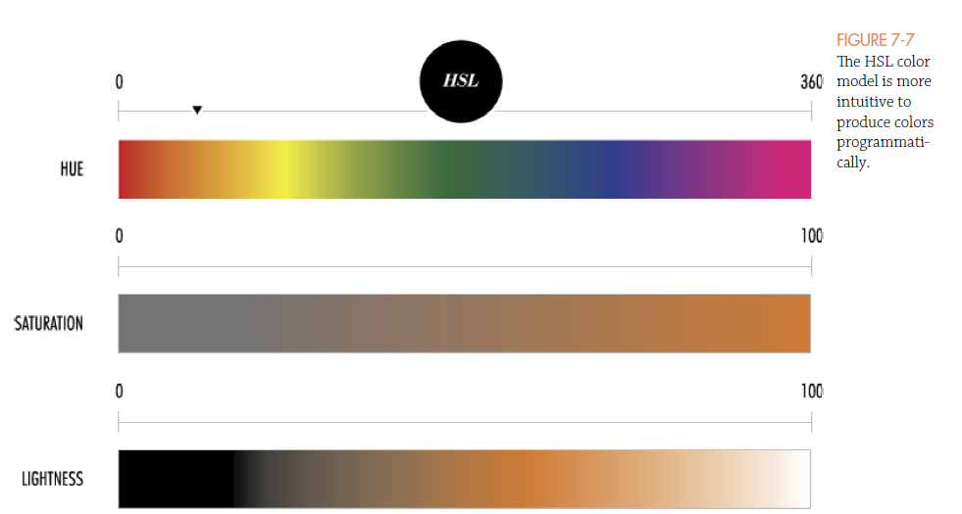
Color Model - HSL

Slide 19
Cold and Warm Colors
Warm colors include red, orange, yellow, and the steps between them.
associated with energy, passion, and enthusiasm and are generally positive.
Cool colors include blue, green, violets, and the colors in between them.
associated with feeling relaxed, reserved, and can give sense of professionalism and stability.

Slide 20
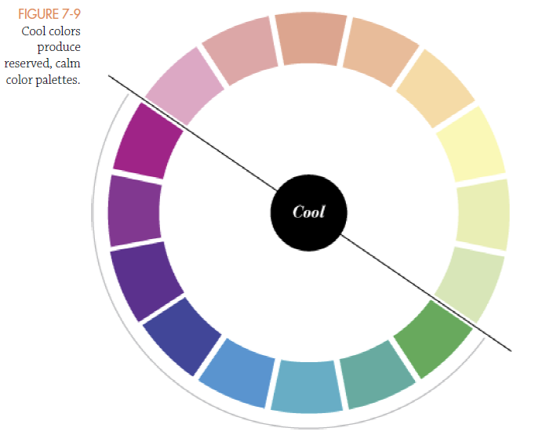
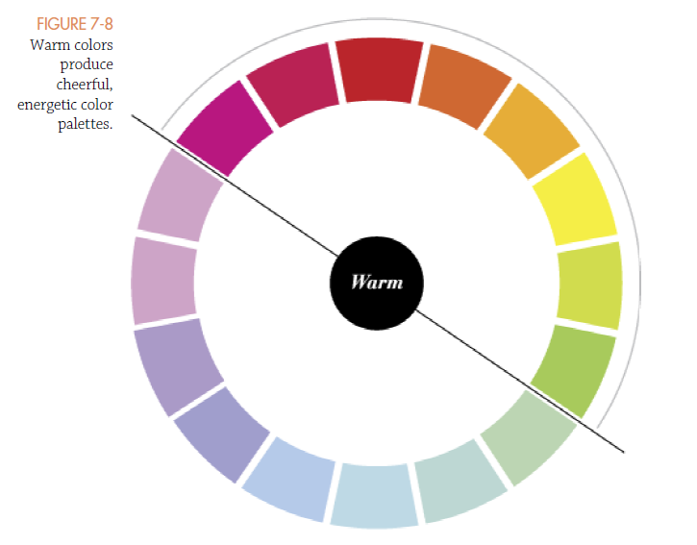
Cold and Warm Colors

Slide 21
Color Palettes
Color palettes are color combinations that work well

Slide 22
Typography
Typography is the art and technique of arranging type to make written language readable and appealing.
The arrangement of type involves selecting typefaces, point size, line length, line-spacing (leading), letter-spacing (tracking), and adjusting the space within letters pairs (kerning).

Slide 23
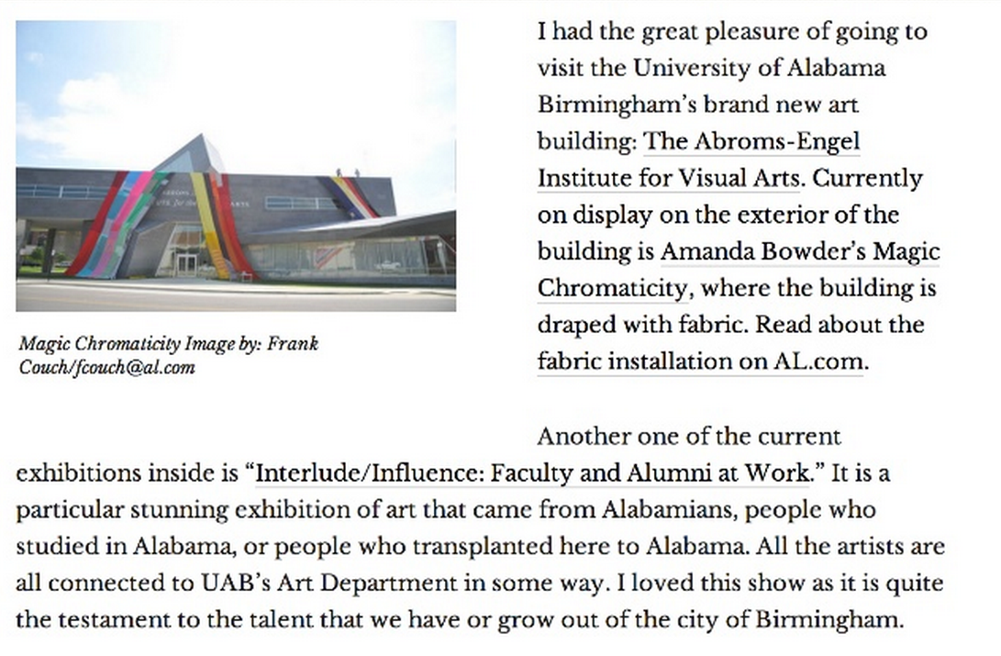
Impacts of Typography

Slide 24
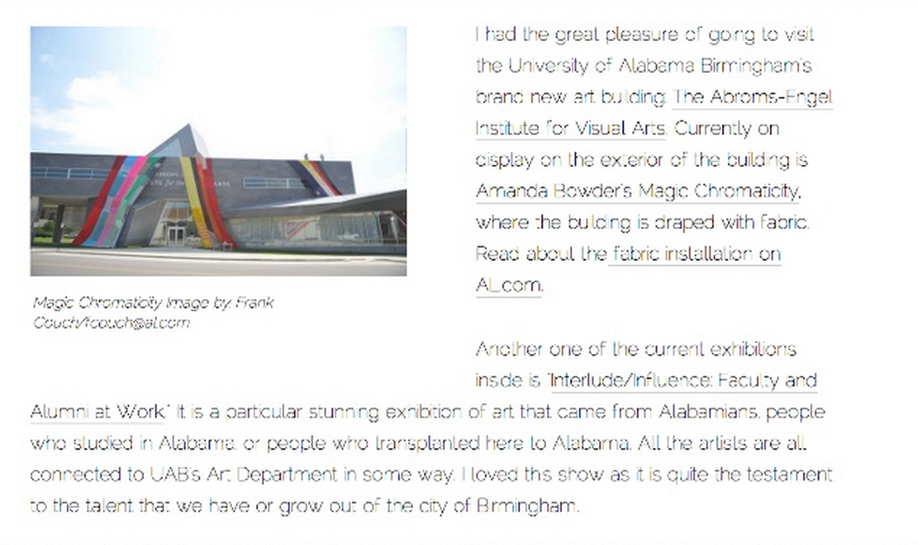
Impacts of Typography

Slide 25
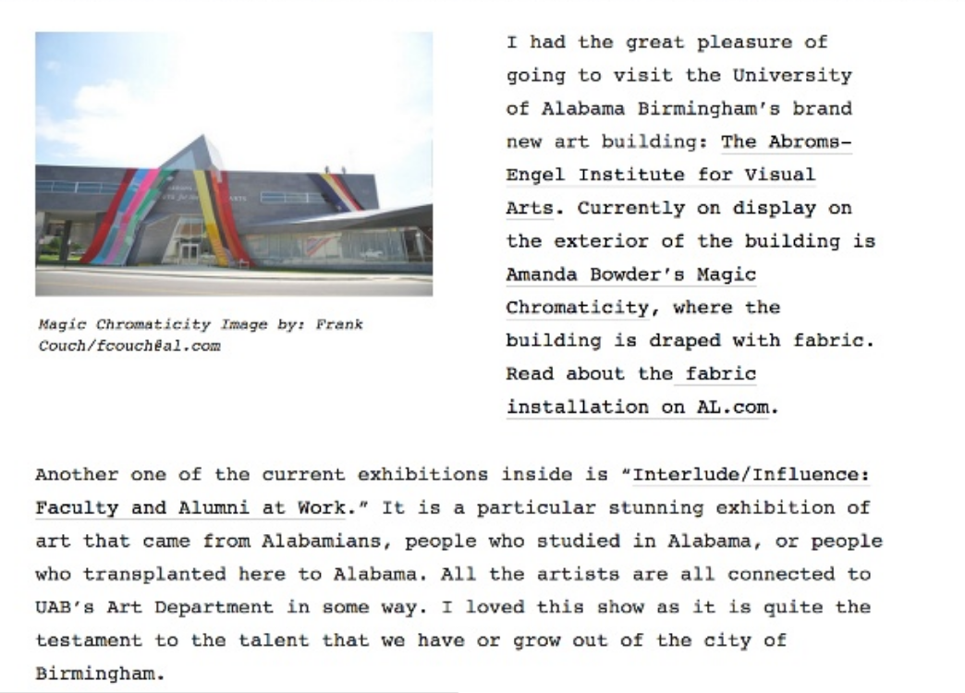
Impacts of Typography

Slide 26
Typography Joke
Party drinks order
1.34 bottles of water
2.30 cans of coke
3.52 cans of diet coke
4.22 bottles of ginger beer
What’s wrong ?

Slide 27
Character anatomy typographic reference of basic names
Aperture
Arm
Ascender
Baseline
Bowl
Counter
Crossbar
Descender
Disgonal stroke
Ear
Finial
Hairline
Ligature
Link
Loop
Serif
Shoulder
Small caps
Spine
Spur
Stem
Tail
Terminal
X-height

Slide 28
Activity 2 Typographic reference of basic names
(Work in Group)
Let’s match the basic names with the character anatomy

Slide 29
Typeface vs Font
Font is a specific member of a type family
Roman, boldface, italic
Typeface is a style (a consistent visual appearances) of fonts

Slide 30
Typeface examples
Serif Typefaces
Serif typefaces have semi-structural details at the ends of their strokes. In other words, serifs are the little “feet” at the end of each letter.
Sans-Serif Typefaces
Sans-serif typefaces are typefaces that don’t contain serifs. (feet)
sans-serifs have become very popular for setting body text.

Slide 31
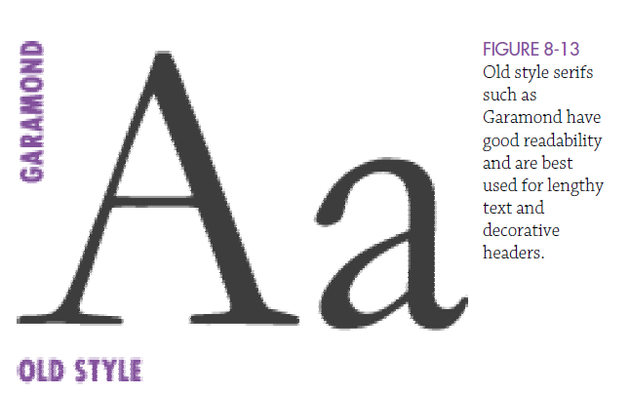
These typefaces can lend themselves to a classic, traditional look
and feel and are well suited for lengthy reading tasks.

Slide 32
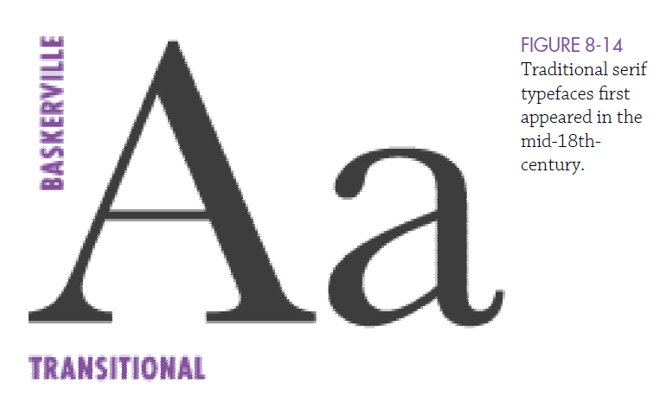
Transitional typefaces inherently have stylish and strong visual characteristics and are most
often used for body text.

Slide 33
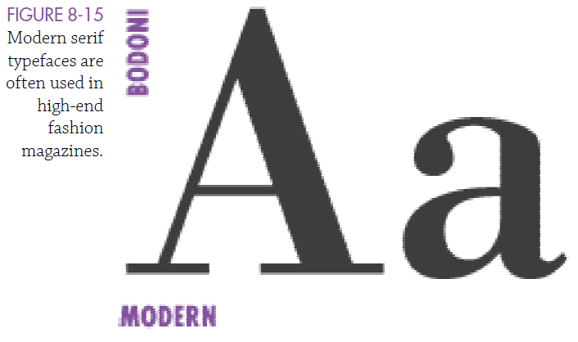
Modern style typefaces can have poor legibility when used at smaller sizes. But when used in large sizes, they are very elegant, sophisticated, and fashionable.

Slide 34
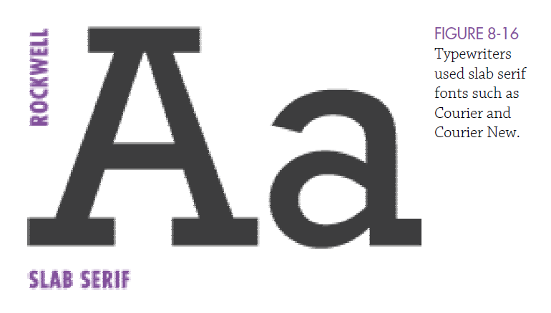
Slab Serif id a kind of
typeface that would stand out on billboards and posters

Slide 35
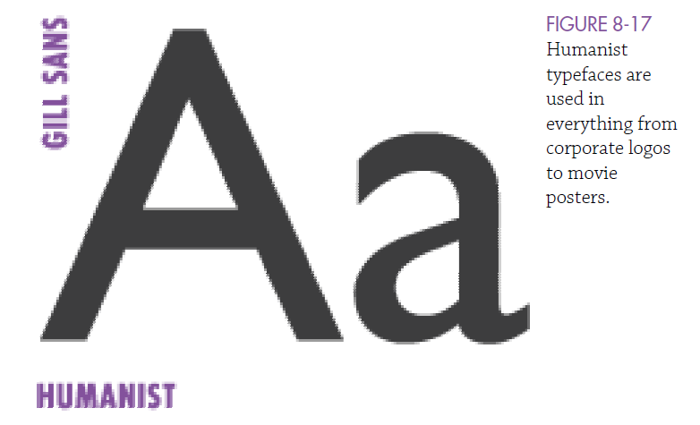
Humanist typefaces can feel modern but not industrial, warm, and can
be very readable

Slide 36
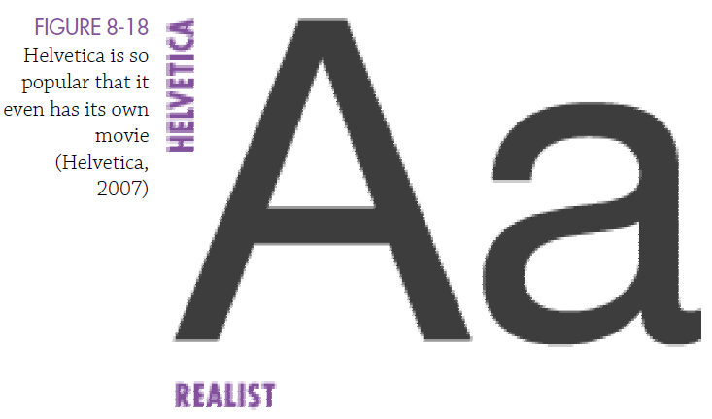
It shows “ordinary” or “anonymous” because of their relatively plain appearance

Slide 37
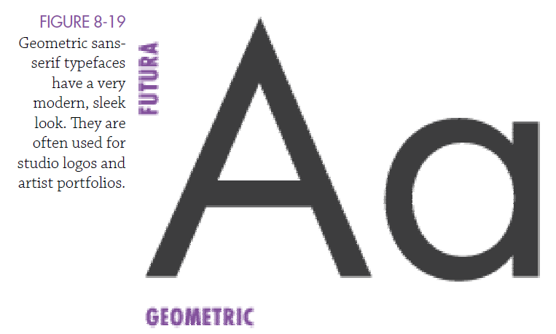
A very modern and clear look and feel.

Slide 38
Ways to Improve Typography
Stick with a scale
Use consistent spacing
Consider the measure
Careful consider font size

Slide 39
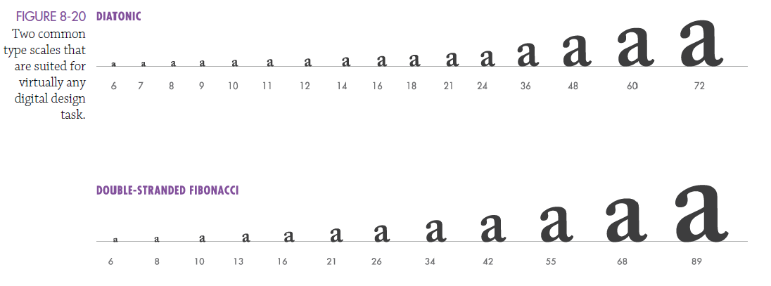
Stick with a scale

Slide 40
Consider Consistent Spacing

Slide 41
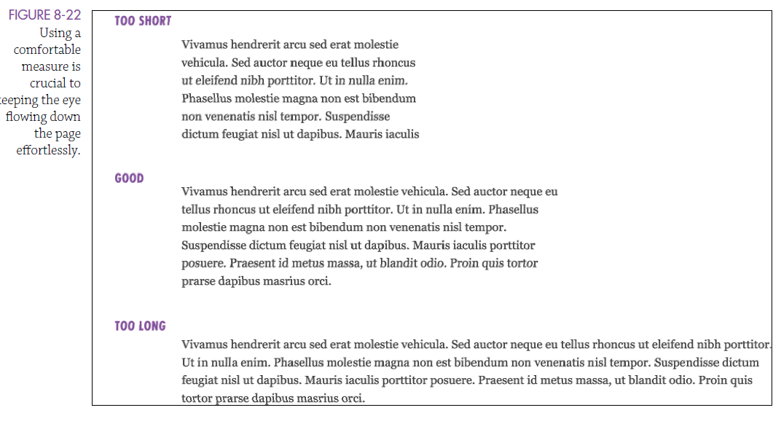
Consider Measures

Slide 42
Before Coming Prac
Complete Career Preparation Module:
Defining my Opportunities

